Slide 1
Survey Plots + Interpretations

Slide 2
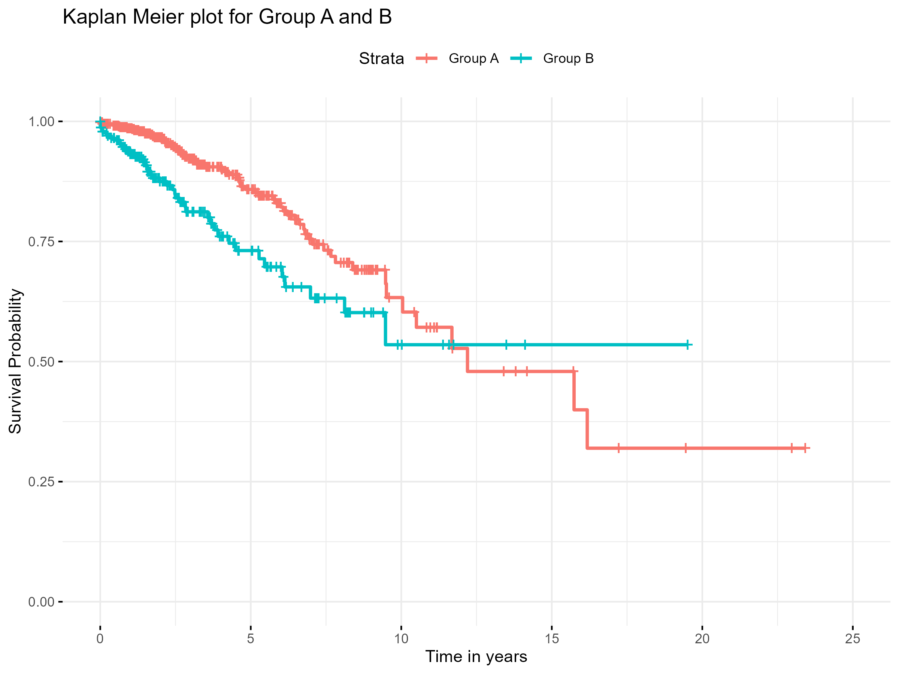
KM1
Notes:
This KM curve compares survival between two patients' groups (Group A and Group B ) over time.
From the start, Patients in Group A had better survival compared to Group B suggesting a better long-term outcome. For example, 5 years post-diagnosis 73% of Group B patients were still alive compared to approximately 84% of Group A patients.
Clinically, this suggests a survival advantage for Group A over Group B.

Slide 3
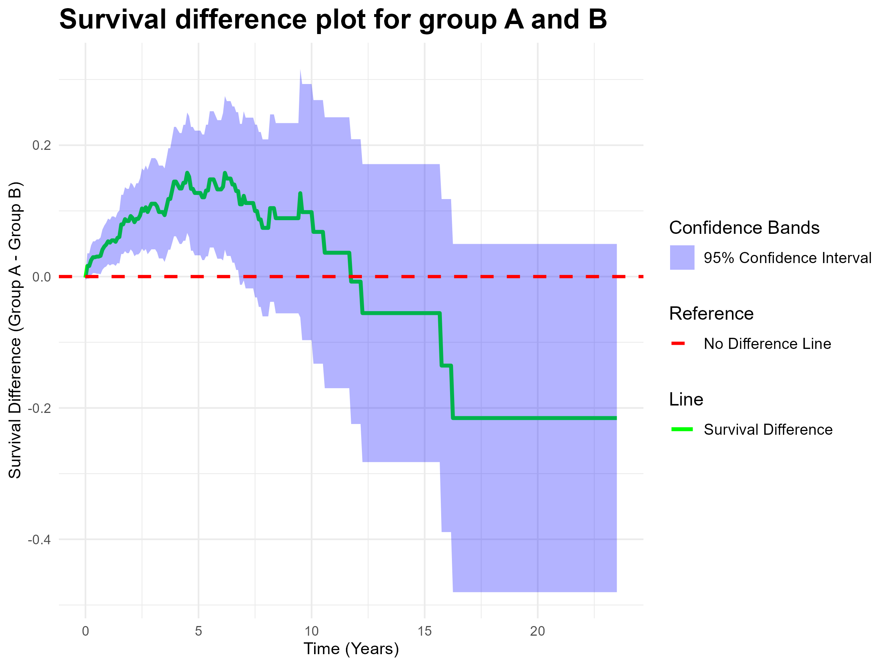
Survdiff1
Notes:
This plot shows the difference in survival between Group A and Group B (Group A - Group B) over time, displayed as a green line, which highlights the improved survival prospects for Group A.
In the first 7 years post diagnosis, Group A has better survival (as seen by the green line and band staying above zero), but this advantage declines later.
The shaded area (in blue) represents the 95% Confidence Interval (CI) for the difference in survival. If the CI does not contain zero there is evidence that the difference in survival is likely to be real and not due to chance. In this example there is evidence of improved survival for Group A from 0 to 7 years approximately as the 95% CI is strictly positive across this range.
Clinically, this suggests that while Group A initially had a more favorable prognosis compared to Group B, the long-term benefit may not be sustained.

Slide 4
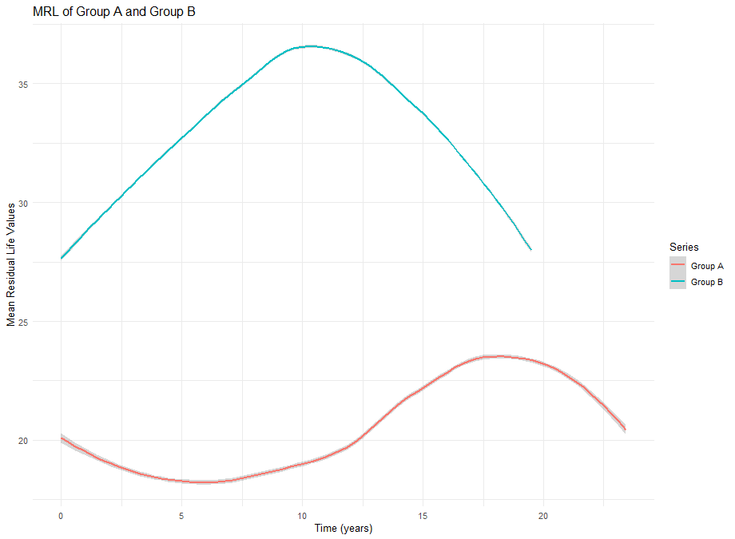
MRL1
Notes:
The MRL plot displays the estimated average remaining lifetime for patients who have already survived up to a specific time e.g. on average how much time have I left given I have survived 2 years?
For example, given that patient is still alive 10 years post diagnosis , the expected remaining life for Group B is about 36 years, compared to only about 19 years for Group A.
Clinically, this graph highlights that patients in Group B have a higher mean residual life compared to Group A.

Slide 5
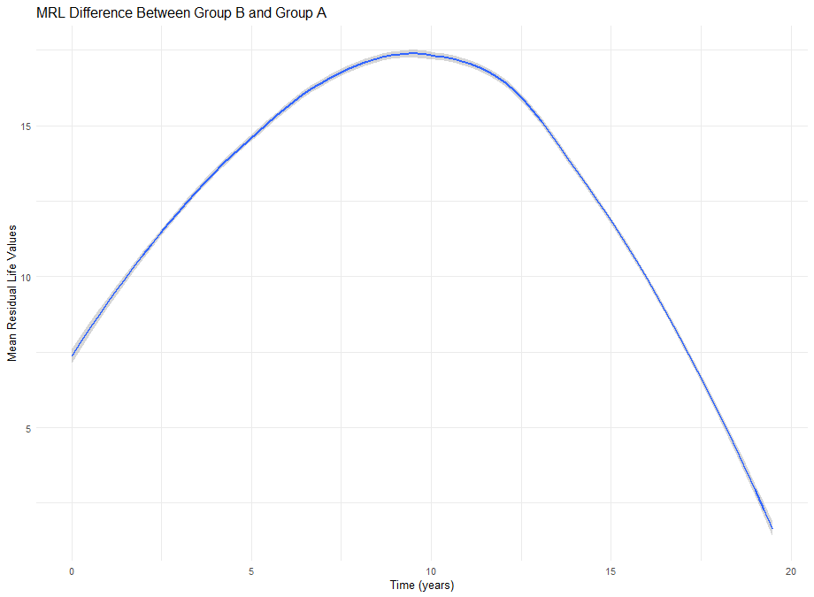
MRL diff 1
Notes:
The MRL difference plot quantifies how much longer patients in Group B are expected to live compared to those in group A given than both have survived up to a certain time point post diagnosis.
Group B consistently has a better prognosis, with the difference peaking around year 10 at nearly 17 years. This means 10 years post diagnosis, individuals in Group B can expect to live, on average, 17 years longer than those in Group A . However , the groups become more similar in their remaining life expectancy in later years.

Slide 6
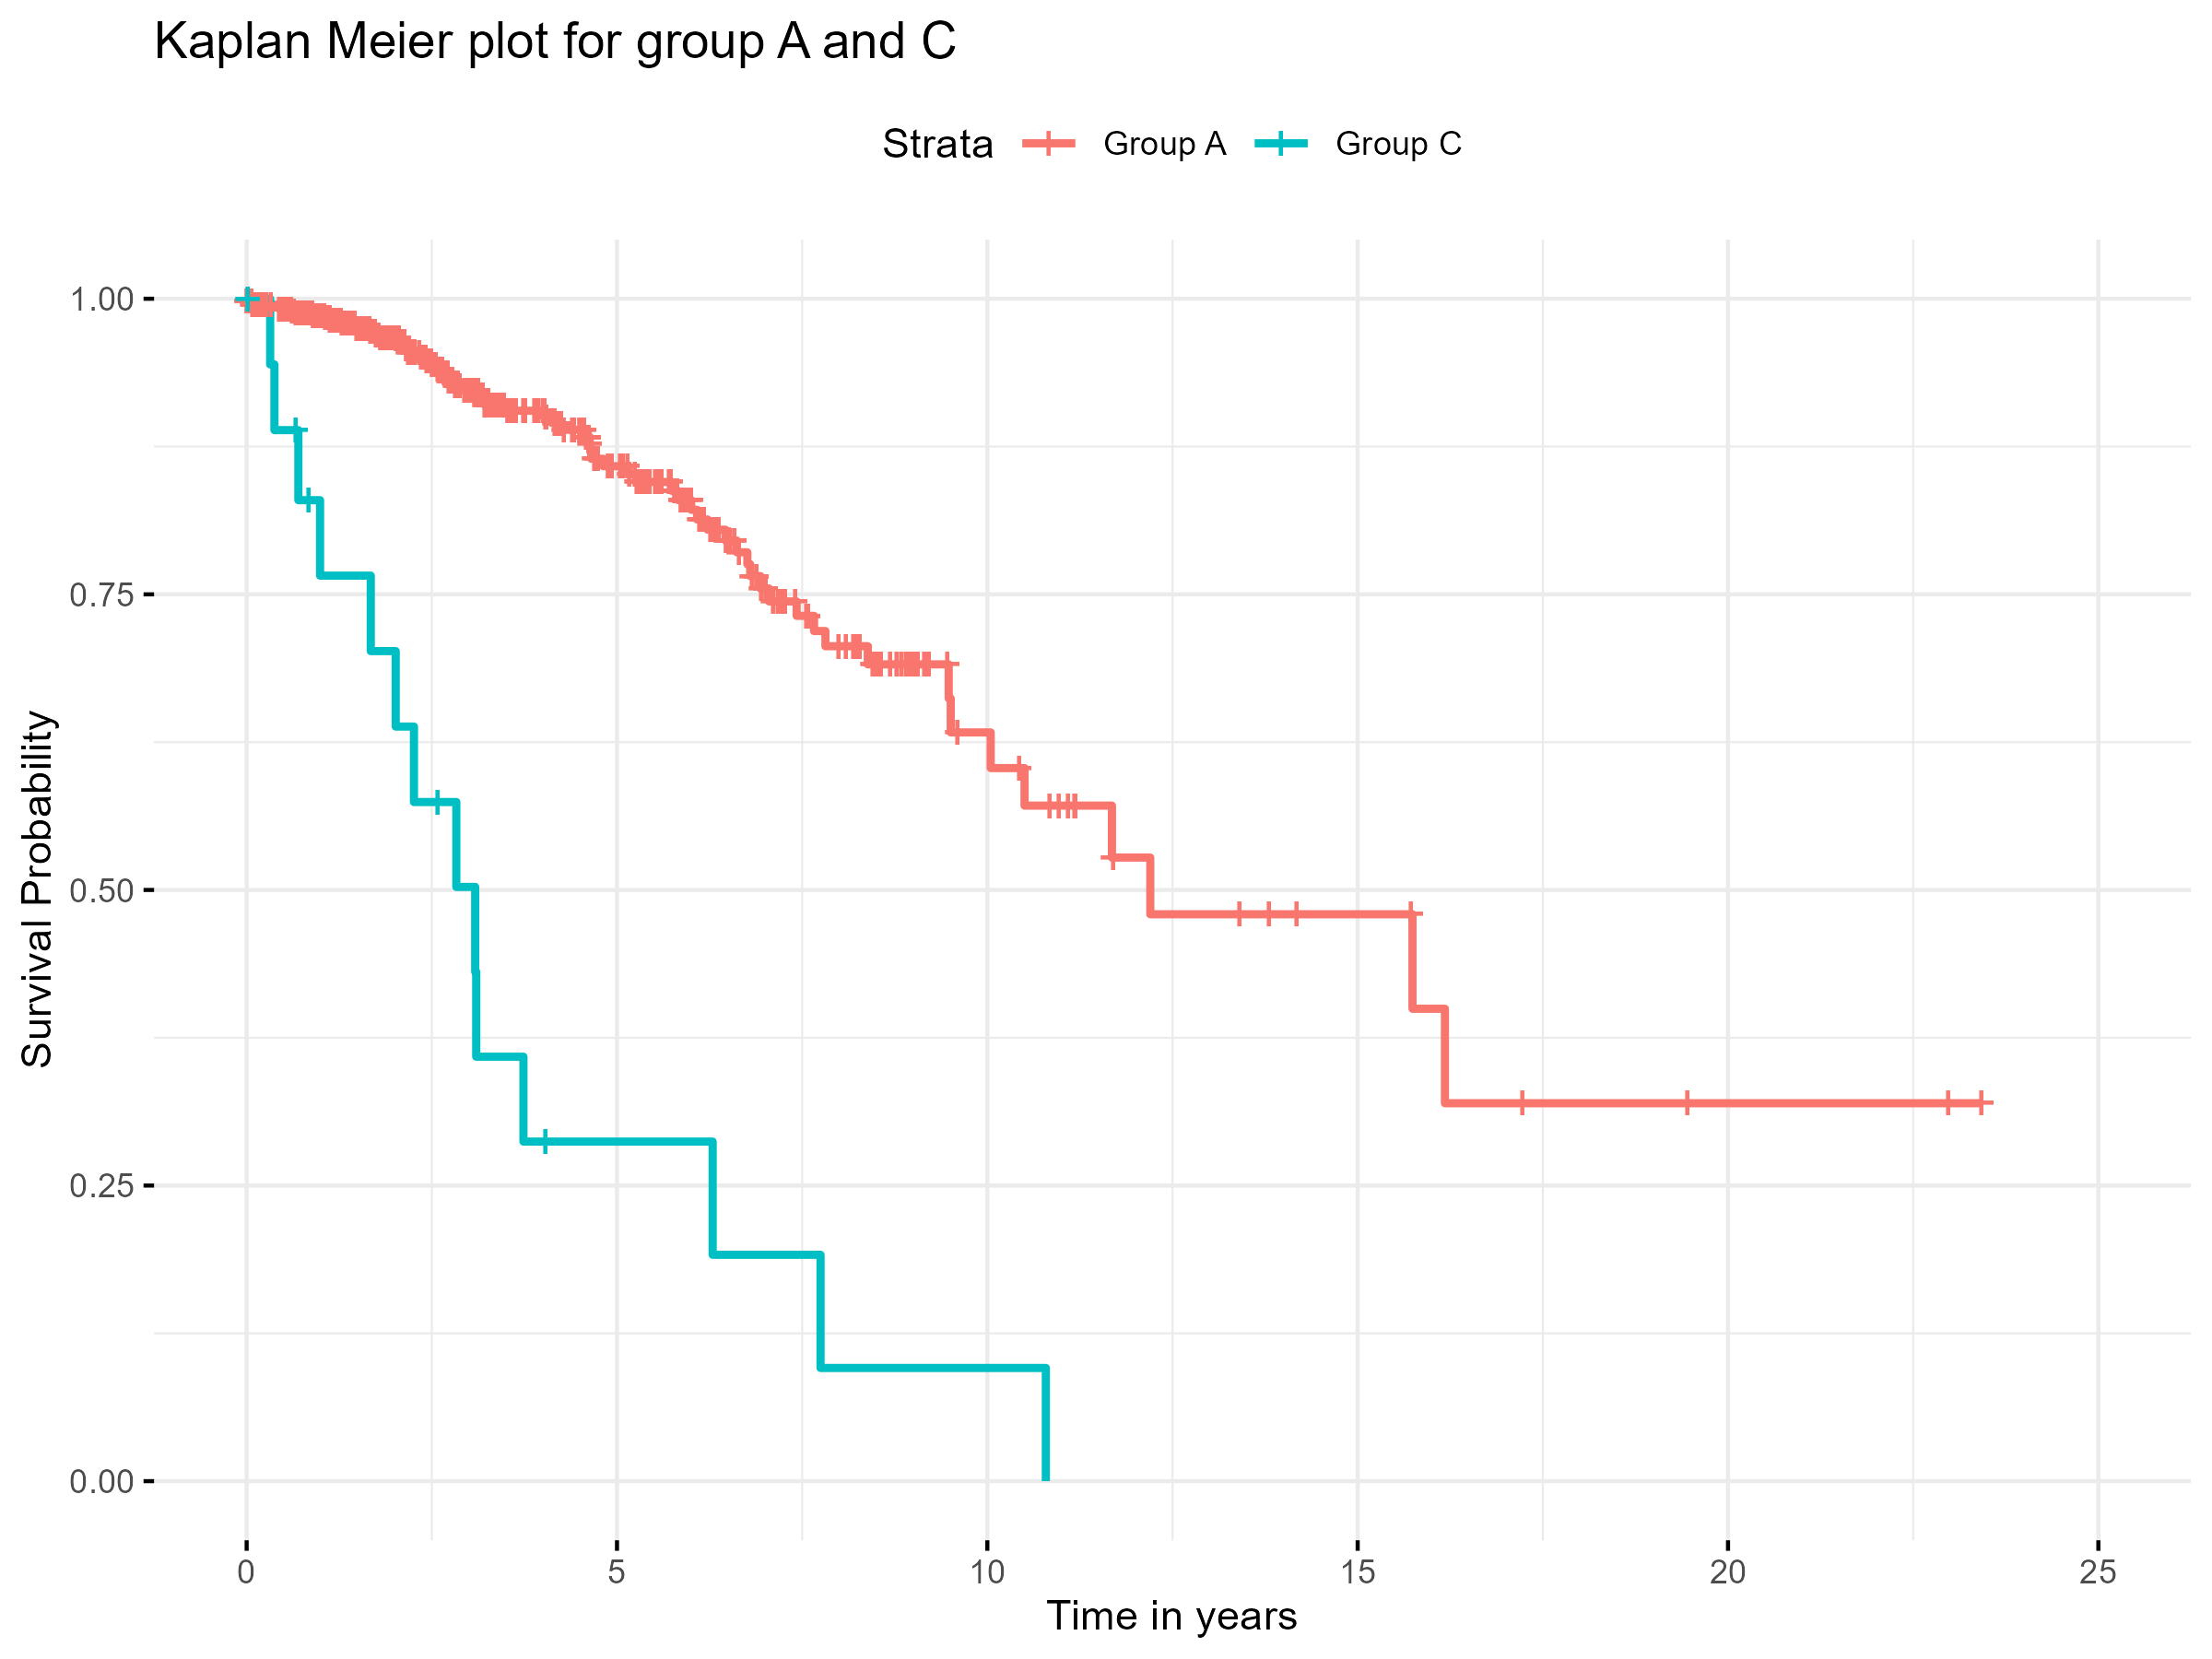
KM Plot 2
Notes:
This KM curve compares survival between two patients' groups (Group A and Group C ) over time.
From the start, Patients in Group A had better survival compared to Group C suggesting a better long-term outcome. For example, 5 years post-diagnosis 30% of Group C patients were still alive compared to approximately 84% of Group A patients.
Clinically, this suggests a survival advantage for Group A over Group C.

Slide 7
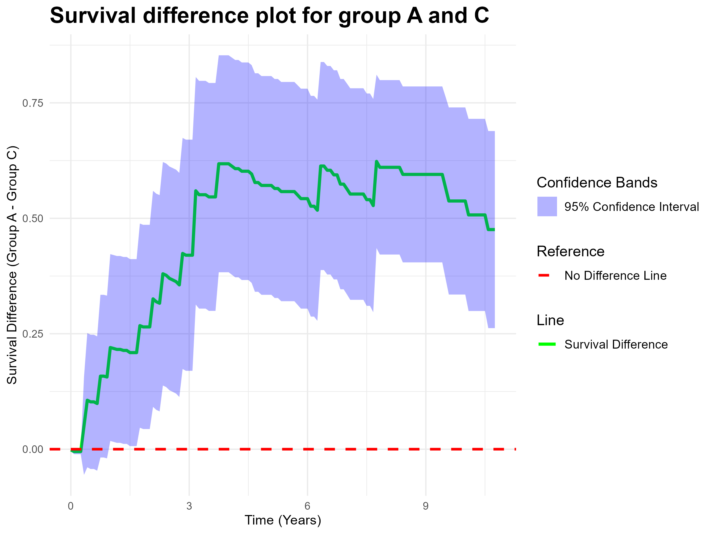
Surv diff 2
Notes:
This plot shows the difference in survival between Group A and Group C (Group A - Group C) over time, displayed as a green line, highlighting the improved survival prospects for Group A.
Group A has better survival (as seen by the green line and band staying above zero), but in the first year, the survival difference was not significant as the condifence band crosses the no difference line.
The shaded area (in blue) represents the 95% Confidence Interval (CI) for the difference in survival. If the CI does not contain zero, there is evidence that the difference in survival is likely to be real and not due to chance. In this example, there is evidence of improved survival for Group A from the first year post-diagnosis onwards.
Clinically, this suggests that Group A initially had a more favorable prognosis compared to Group C.

Slide 8
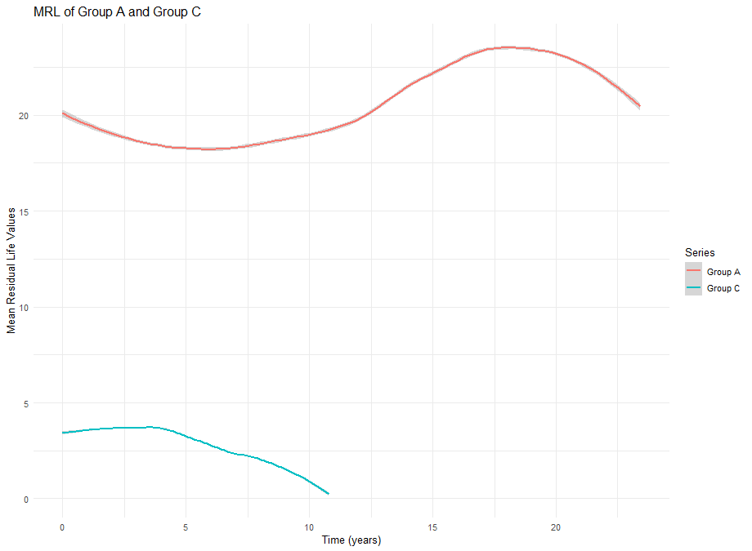
MRL 2
Notes:
The MRL plot displays the estimated average remaining lifetime for patients who have already survived up to a specific time e.g. on average how much time have I left, given I have survived 2 years?
For example, given that the patient is still alive 5 years post-diagnosis, the expected remaining life for Group A is about 17 years, compared to only about 3.5 years for Group C.
Clinically, this graph highlights that patients in Group A have a higher mean residual life compared to Group C.

Slide 9
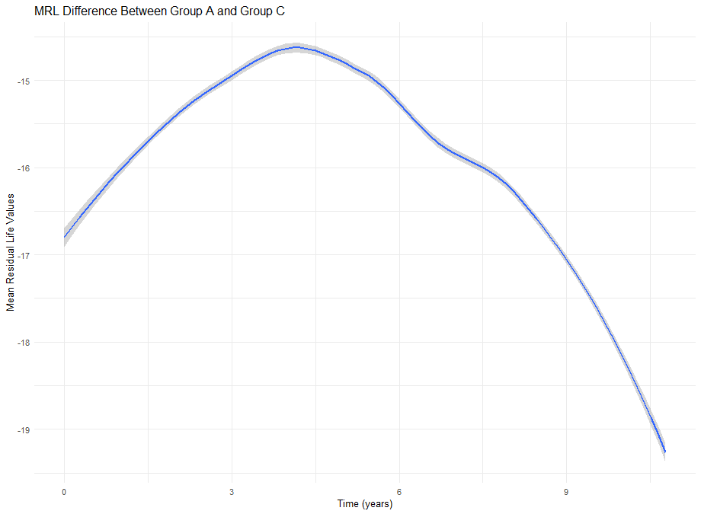
MRLdiff 2
Notes:
The MRL difference plot quantifies how much longer patients in Group A are expected to live compared to those in group C given than both have survived up to a certain time point post diagnosis.
Group A consistently has a better prognosis, In the first 4 years , the difference has been decreasing but after Year 4, the difference consistently increased .
This means 10 years post diagnosis, individuals in Group A can expect to live, on average, 14 years longer than those in Group C .

